Slide 1
For Live Session
UNIT 3

Slide 2
For Live Session: Unit 3
Part 1: We would like to analyze the Left Midfielders (LM) versus the Left Forwards (LF). (Estimated / expected time: 2 – 4 hours and at least 2+ slides).
Using the FIFA player data set, filter the data set to create a dataframe that has just the Left Midfielders (LM) and Left Forwards (LF).
Use Ggally and ggpairs() and the dataset you created above above, to plot the categorical variable Position (LM and LF), versus the continuous variables Acceleration and Agility.
Given the plot above, what relationships do you see? Comment on these.
Your client would like to formally test if the mean agility rating of left midfielders is different than that of the left forwards. Perform a 6 – step t-test to test for the difference in these means. (You may skip step 2 (draw and shade) if you like. If you are unfamiliar with the 6-step hypothesis test, see Stat 1 slides or the Bridge Course to review the 6-step hypothesis test.)
Are the assumptions of this test reasonably met? If you have not had Stat 1, simply create a histogram of the agility scores for both groups (LM and LF) and given what you know about the CLT, comment on if you believe the sampling distribution of sample means (of your sample size) will be reasonably normal. In addition, does there look like there is significant visual evidence to suggest the standard deviations are different? ….. If you have had Stat 1, create the plots listed above (and any other plots you might prefer) and be prepared to be a teacher and teach what you know about the assumptions of the t-test and if those are assumption are reasonably met here.

Slide 3
For Live Session: Unit 3
Part 2: (Estimated / expected time 3-5 hours and at least 3+ slides)
Select/create at least 2 categorical variables and select two continuous variables and perform an EDA. Also, at least one of the categorical variables should be created from a continuous variable (using the cut() function).
Use these variables to explore the data and tell a story of what you discovered similar to what was shown in the asynch videos. You do not need to go so far as to use linear regression, but let your curiosity guide you along the way and feel free to use methods you are familiar with that are appropriate to answering those questions. Your evidence could be purely visual or could include additional methods, it is up to you… just do your best and have fun!

Slide 4
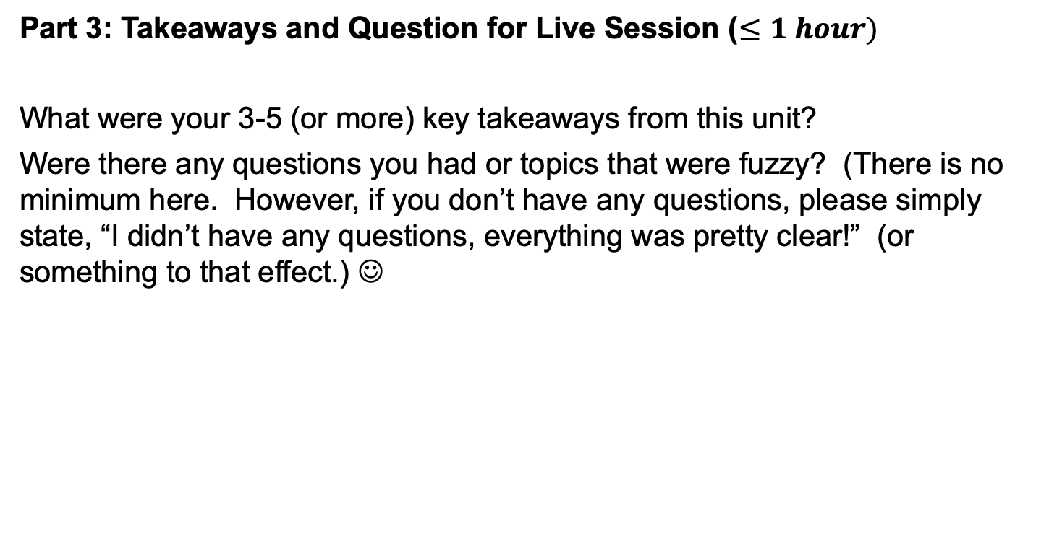
For Live Session: Unit 3
Part 3: Takeaways and Question for Live Session ($≤1 hour)$
What were your 3-5 (or more) key takeaways from this unit?
Were there any questions you had or topics that were fuzzy? (There is no minimum here. However, if you don’t have any questions, please simply state, “I didn’t have any questions, everything was pretty clear!” (or something to that effect.) ☺

